Slide 1

Powering Sustainability: A Case Study in Smart Grid Analytics
This presentation explores a real-world application of data science and big data analytics to optimize energy management in a Moroccan city. We delve into the challenges faced by Amendis, a public-private utility provider, and the solutions developed through descriptive and predictive analytics.
Mahny Barazandehtar
Ali Abbasi Dolatabadiv

Slide 2
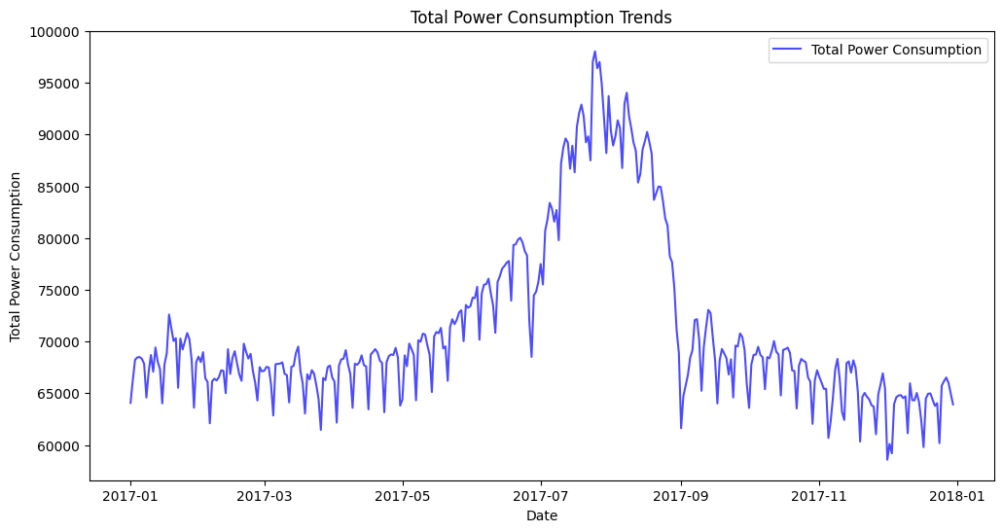
Is there a trend? Is there a relation?
Total power consumption in Tetouan City, Morocco.

Slide 3
The Challenge: Balancing Energy Demand in Tetouan
The Problem
The Need for Action
Amendis, the utility provider for Tetouan City, Morocco, faces a significant challenge in balancing energy production with fluctuating consumption patterns. The city's power distribution network experiences periods of peak demand, particularly during summer months due to air conditioning usage. This leads to operational inefficiencies and potential grid instability.
Amendis recognizes the need to optimize its energy management practices. This includes understanding past consumption trends, predicting future demand, and exploring the integration of renewable energy sources. Data science and big data analytics offer powerful tools to address these challenges.

Slide 4

Phase 1: Unveiling Insights with Descriptive Analytics
Data Exploration
The first phase focused on exploring historical SCADA (Supervisory Control and Data Acquisition) data collected from Amendis' power distribution network. The analysis aimed to understand past consumption patterns and identify key influencing factors.

Slide 5
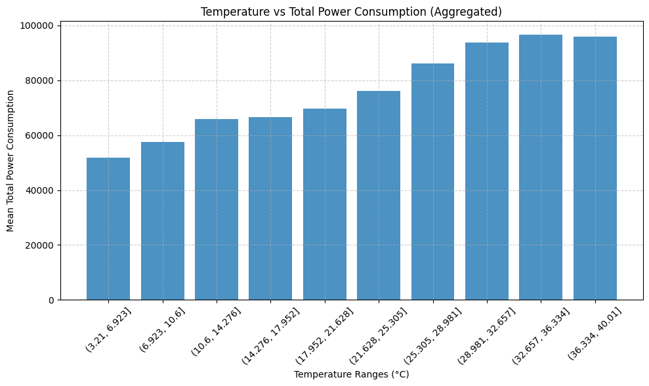
Temperature
Correlation Analysis
Correlation analysis revealed strong positive correlations between temperature and power consumption. This indicates that higher temperatures lead to increased energy demand, primarily due to the use of air conditioning.

Slide 6
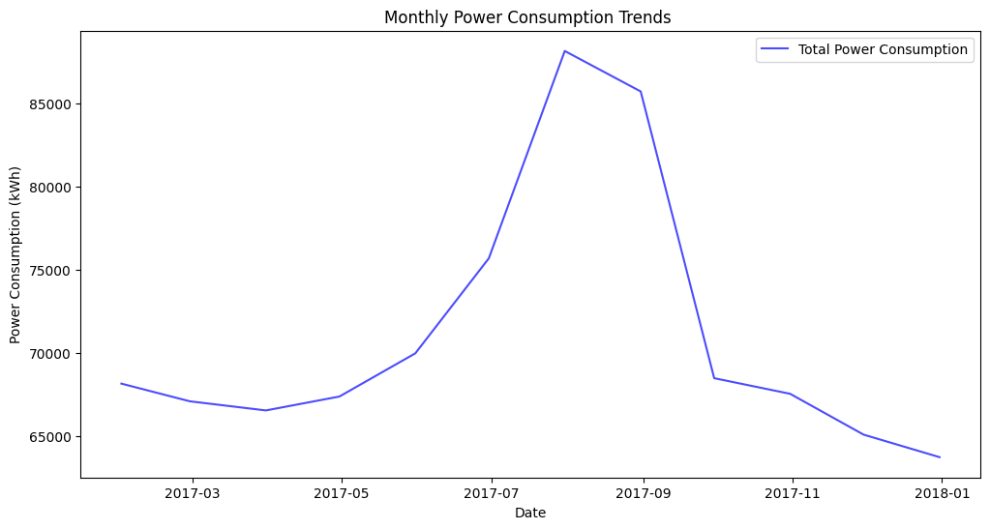
Time analysis
Temporal Trend Visualization
Temporal trend visualization highlighted peak usage periods, revealing that power consumption peaks during evening hours and summer months. This information is crucial for optimizing resource allocation and anticipating future demand.

Slide 7
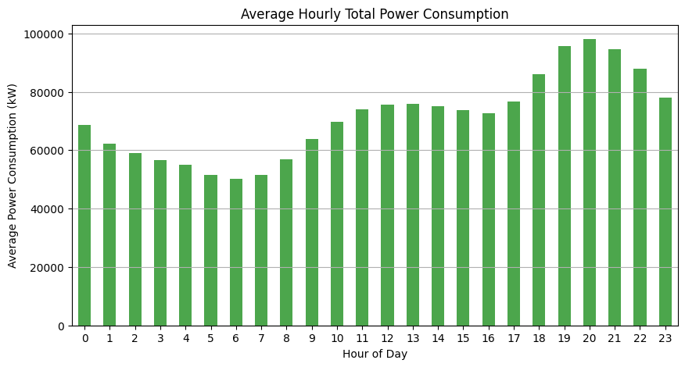
Time analysis (cont.)
Mean Power consumption during daily hours.

Slide 8
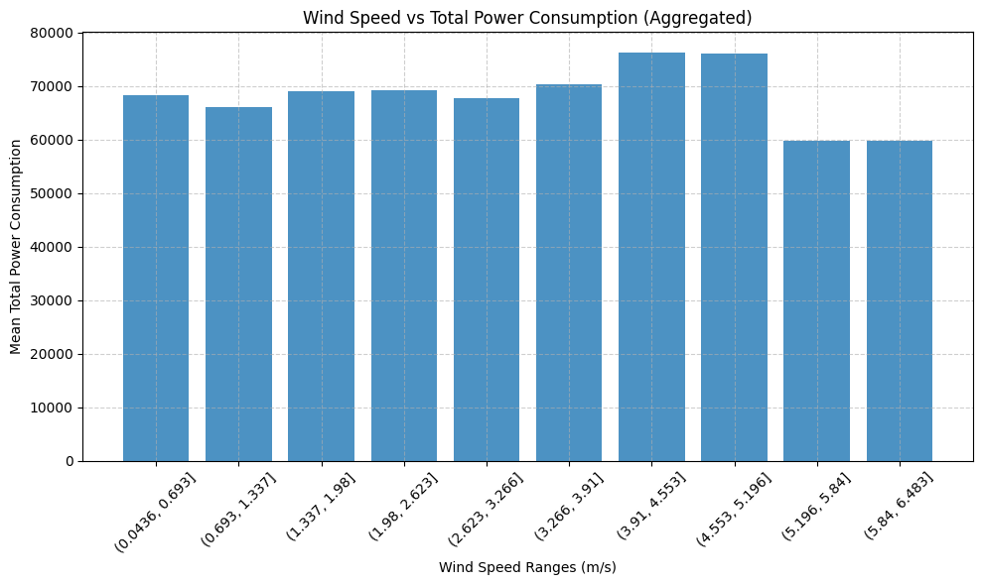
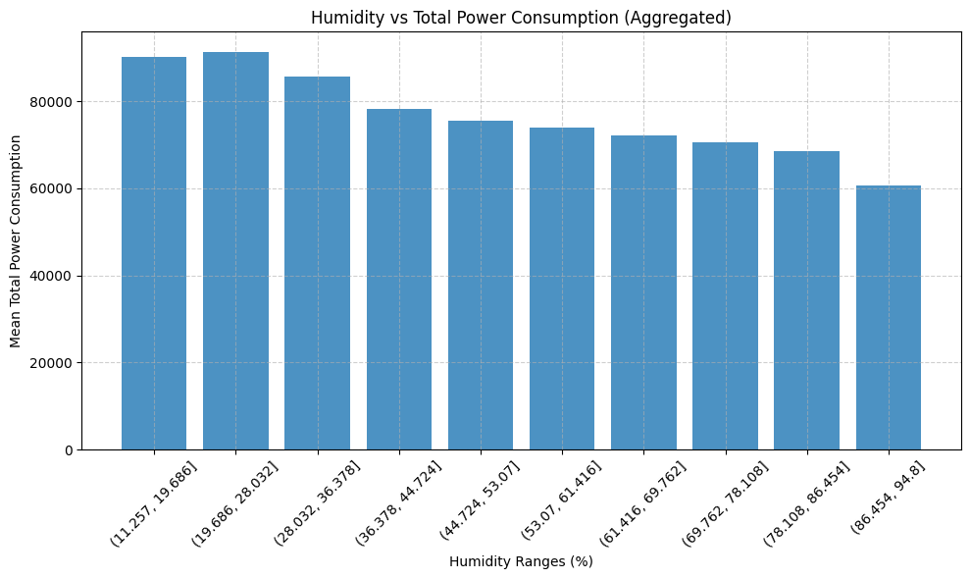
Wind speed :
Humidity :

Slide 9
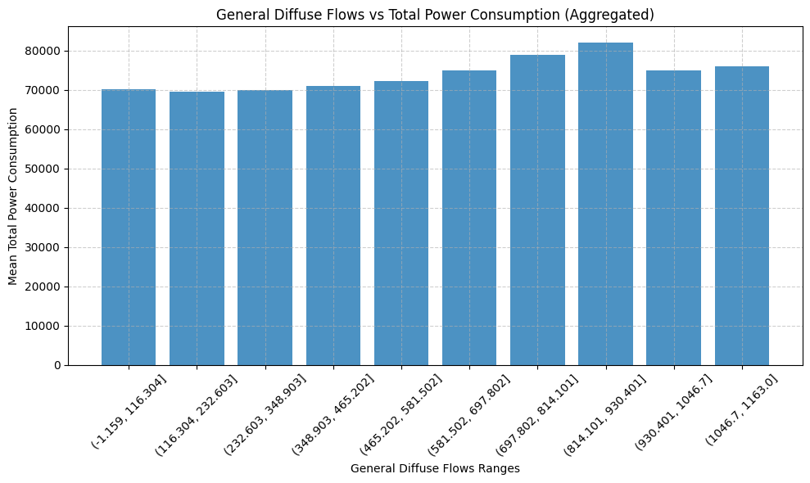
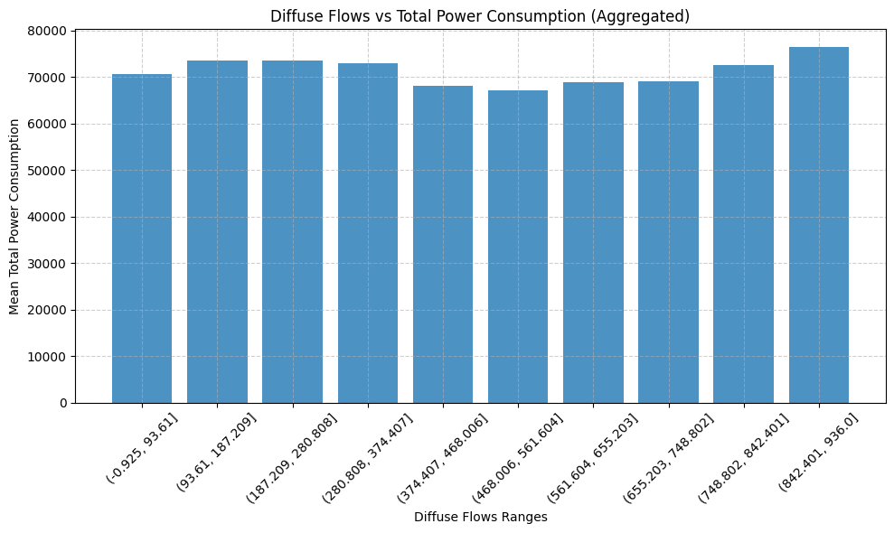
General diffuse flows
Diffuse flows

Slide 10
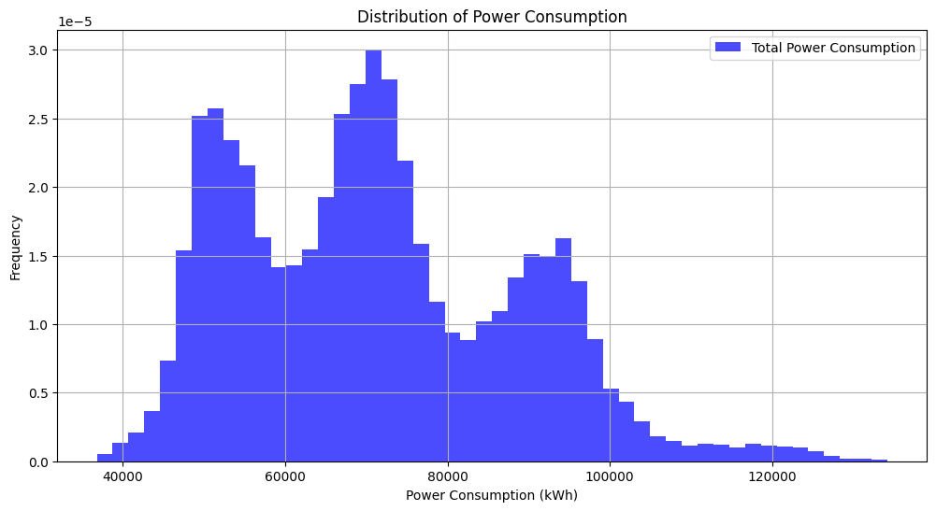
Power consumption distribution
The company should precisely concentrate on values around 50000 kW/h and 70000 kW/h, which are the most frequent values.

Slide 11
Phase 2: Predicting the Future with Machine Learning
Model Selection
Model Performance
The second phase employed supervised machine learning methods to predict future energy demand. Three models were evaluated: Linear Regression, Gradient Boosting Regressor (GBR), and K-Nearest Neighbors (KNN).
K-Nearest Neighbors outperformed the other models, achieving the highest R² score (0.98), indicating its ability to capture complex relationships in the data and predict future consumption patterns with high accuracy.

Slide 12
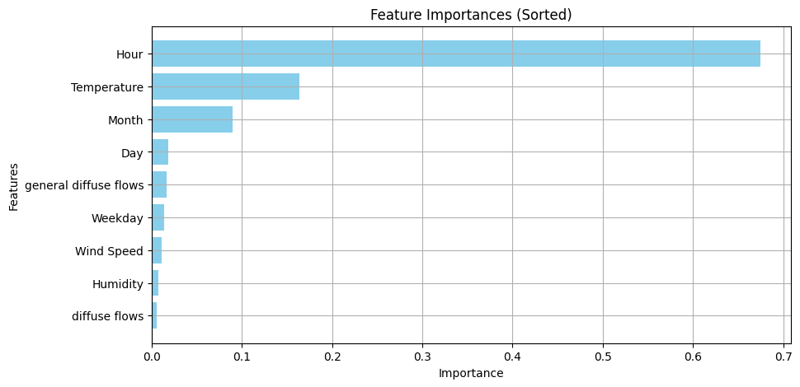
Feature selection
We ran a Random Forest model (with 150 estimators) on the whole dataset to extract the important features.

Slide 13
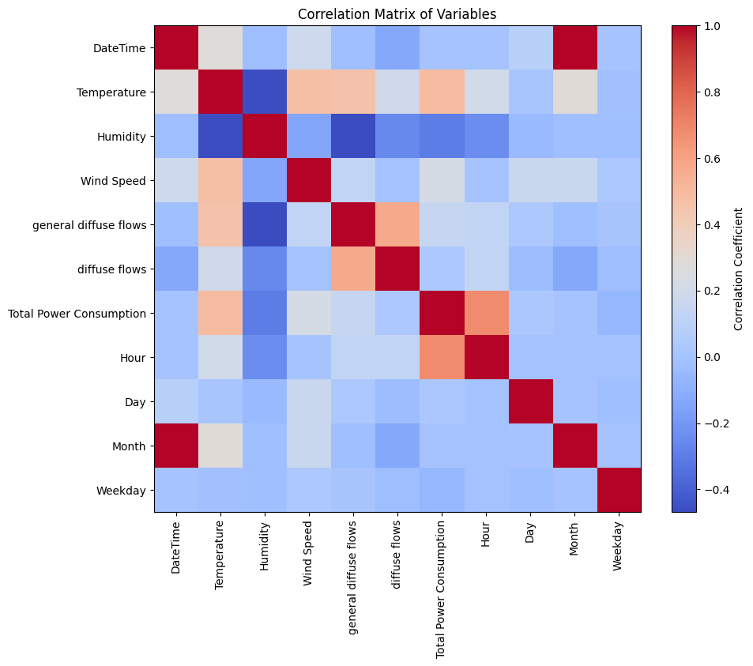
Feature selection (cont.)
See the relation between Power consumption and other features.
Pay attention to the temperature, Hour, and Month features.

Slide 14
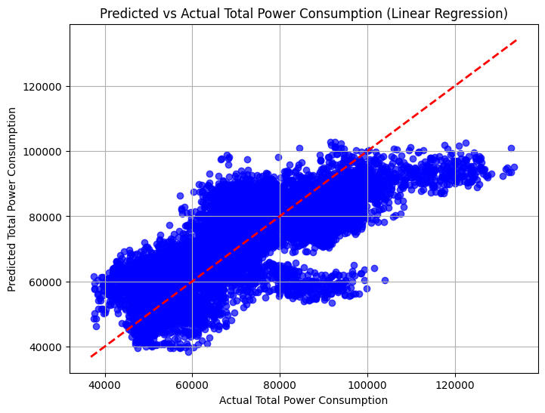
Linear Regression
Mean Absolute Error (MAE): 8526.72
Root Mean Squared Error (RMSE): 10877.59
R-squared (R2): 0.61
Explained Variance Score: 0.61

Slide 15
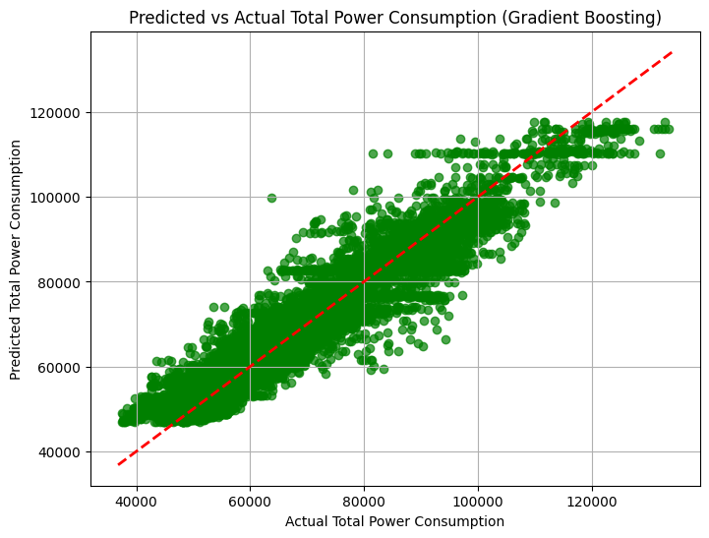
Gradient Boosting Regression
Mean Absolute Error (MAE): 3830.76
Root Mean Squared Error (RMSE): 5192.12
R-squared (R2): 0.91
Explained Variance Score: 0.91

Slide 16
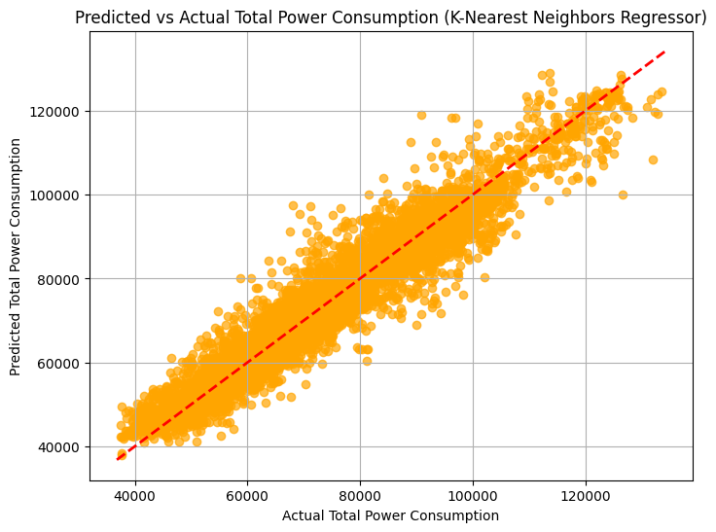
K-Nearest Neighbors Regression
Mean Absolute Error (MAE): 2821.30
Root Mean Squared Error (RMSE): 4116.75
R-squared (R2): 0.94
Explained Variance Score: 0.94
Cross-Validation Results (R²) with 5 Folds:
Mean Cross-Validation R²: 0.98

Slide 17




Key Findings: Driving Sustainable Solutions
Temperature Impact
Peak Load Periods
Analysis revealed a strong correlation between temperature and energy demand, particularly during peak periods. This understanding allows Amendis to anticipate and adjust resource allocation based on weather forecasts.
Predictive models identified specific peak load periods, allowing Amendis to implement proactive strategies such as dynamic bandwidth adjustments to optimize energy distribution and avoid grid instability.
Renewable Energy Potential
The analysis highlighted areas within Tetouan with high solar radiation and consistent wind speeds, making them ideal locations for deploying solar and wind energy projects to contribute to a sustainable energy future.

Slide 18

Actionable Recommendations for a Sustainable Future
Dynamic Bandwidth Adjustments
Renewable Energy Integration
Prioritize the integration of renewable energy sources, such as solar and wind power, in areas with high solar radiation and consistent wind speeds, reducing reliance on fossil fuels and promoting a sustainable energy mix.
Implement dynamic bandwidth adjustments based on temperature and time-of-day patterns to optimize supply during peak demand periods, reducing operational inefficiencies and ensuring grid stability.
Dynamic Pricing Strategies
Introduce dynamic pricing strategies to incentivize consumers to shift their energy usage to off-peak hours, reducing grid strain during peak periods and creating a more efficient and cost-effective energy distribution system.

Slide 19
Thank you for your attention

